Slide 1
Crytography
string

Slide 2
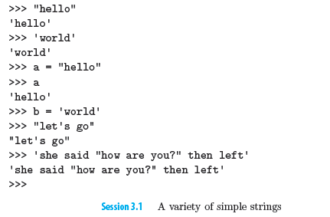
Strings
Strings are made up of a sequence of characters
Strings can contain any characters: letters, numbers, punctuation marks, and even quotation marks.

Slide 3
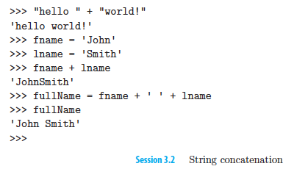
Concatenation
Putting two strings together, one after another

Slide 4
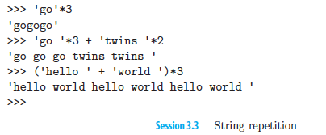
Repetition
* operator takes a string and repeats it as many times as you would like

Slide 5
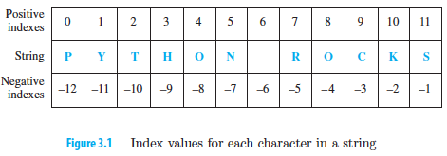
Indexing
index operator [ ], is useful when we want to get at particular characters in a string

Slide 6
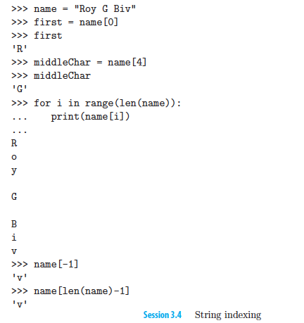
Indexing

Slide 7
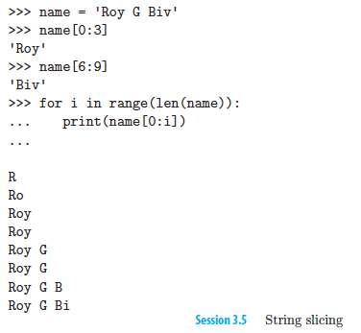
Slicing
The slice operator [:] is similar to the index operator except that it can getsubstrings.

Slide 8
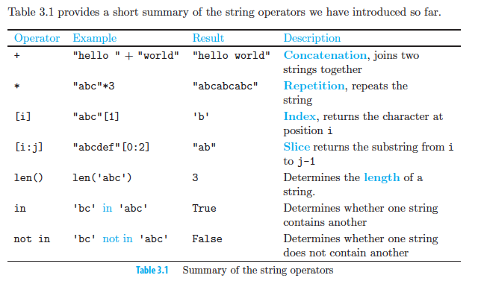
String operations

Slide 9
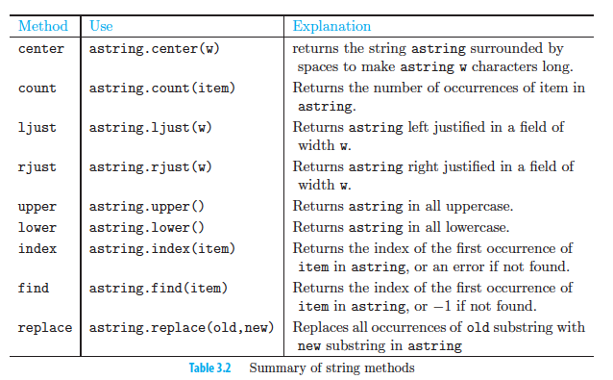
String methods

Slide 10
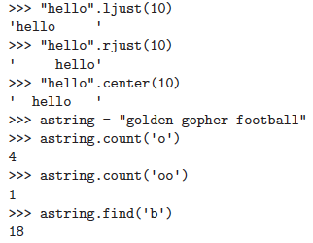
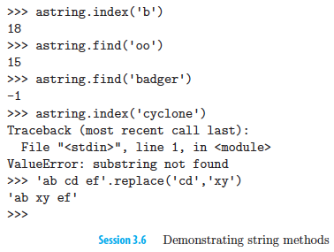
Examples: String methods

Slide 11
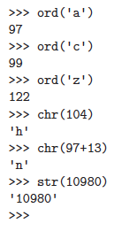
Character Functions
Converting character to integer (ord)
Converting integer to character (chr)
Converting number to string (str)
The mapping from letters to numbers is defined by the American Standard Code for Information Interchange (ASCII) and has been in use since the 1970s.
http://www.ascii.cl/

Slide 12
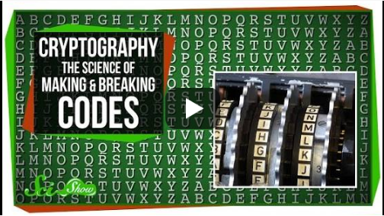
Crytography

Slide 13
cebtenzzvat vf yvxr xvpxvat lbhefrys va gur snpr, fbbare be yngre lbhe abfr jvyy oyrrq
L3_ICE1: Caesar Cipher
Notes:
https://www.youtube.com/watch?v=-yFZGF8FHSg
0:00 – 1:41

Slide 14
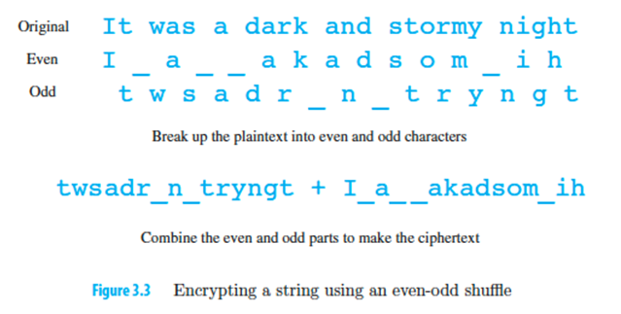
Transposition Cipher
Scramble the letters of a message to separate the message into two groups of characters
Results in a string with the characters shuffled to new positions, we call this a transposition cipher

Slide 15
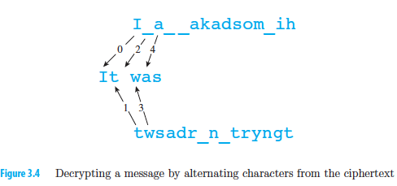
Decrypt: Transposition Cipher
Split the ciphertext to half
First half consist of odd characters in the original text
Second half consist of even characters in original text
We may have one more character in the even character string than we do in the odd character string.
We compare the lengths of the two strings. If the odd-numbered character string is shorter than the even, we simply concatenate the last character from the even string onto the plaintext.

Slide 16
Transposition Cipher
L3_ICE2

Slide 17
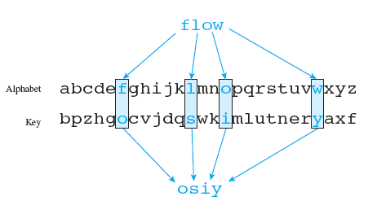
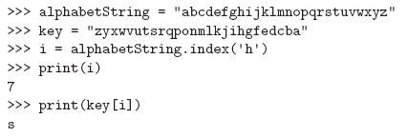
Substitution Cipher
Substitutes one letter for another throughout a message
Uses ciphertext key to encrypt
Notes:
Another monoalphabetic cipher: Substitution Cipher

Slide 18
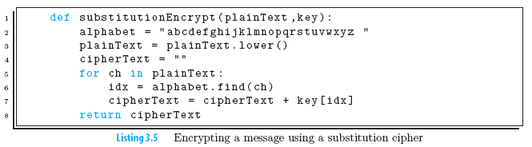
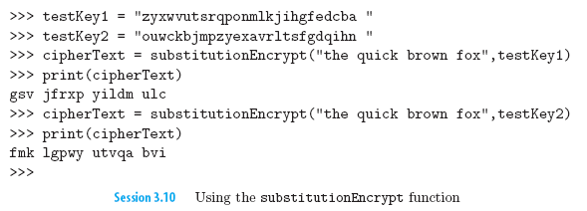
Substitution Cipher

Slide 19
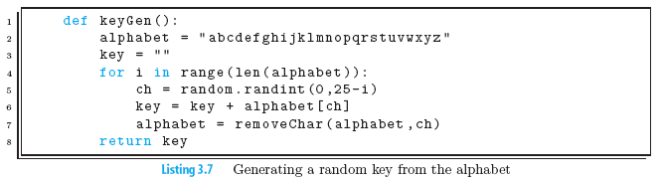
Randomly Creating A Key

Slide 20
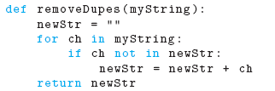
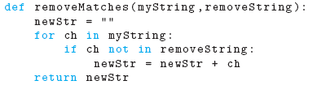
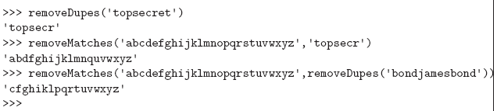
Creating a key using a password
Select a password, e.g., “topsecret”
Remove duplicates from password, e.g. “topsecr”
Split the alphabetlist to parts beforeLast, and afterLast
beforeLast: “abcdefghijklmnopqr”
afterLast: “stuvwxyz”
Remove characters in password from the
beforeLast and afterLast:
New beforeLast: “abdfghijklmnq”
New afterLast: “uvwxyz”
Put together the 3 parts in this
order: <password><afterLast><beforeLast>
Key = “topsecruvwxyzabdfghijklmnq”

Slide 21
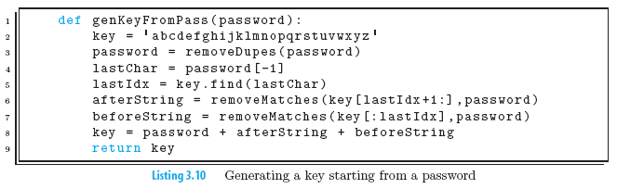
Creating a key using a password

Slide 22
Security of substitution cipher
Suppose we don’t know the key but we want to try to read the secret message anyway.
One possibility would be to simply use brute force, a method in which we try all possible keys until we get plaintext that makes sense. Since the number of keys is equivalent to the number of different ways we can rearrange the 26 letters of the alphabet, there are 26! or 403 x 10²⁴ possible keys. Suppose that we were able to try 1,000,000 keys every second. To try all possible keys would take us 12,788,288,341,153 years.
That is 12 trillion years, roughly a thousand times older than estimates of the age of the universe!
However, substitution cipher is quite easy to break by exploiting some simple characteristics of the English language. So easy in fact that the substitution cipher regularly appears in daily newspapers next to the crossword puzzle under the name of “Cryptoquip.”
The main reason the substitution cipher is easy to break is that there is a one-to-one mapping between letters in the key and letters in the plaintext alphabet. This means that if plaintext “e” maps to ciphertext “k” then it will do so consistently throughout the message. But since “e” is the most common letter in the language, “k” will probably be the most common letter in the ciphertext.
This observation gives us a head start in figuring out the rest of the letters.
Notes:
https://www.youtube.com/watch?v=-yFZGF8FHSg
1:40 – 3:01

Slide 23
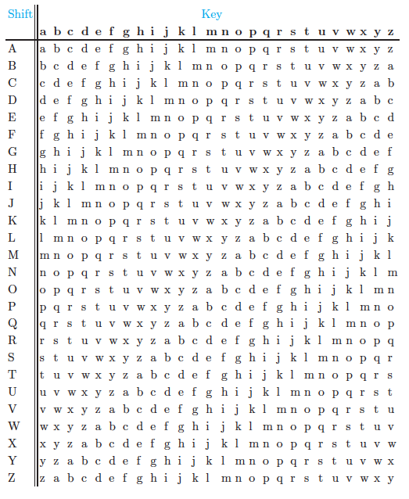

Vigenère Cipher
The key to cracking a substitution cipher was first discovered by Arab scholars in the ninth century, but it was not widely known in the west until the fifteenth century. Once frequency analysis of ciphers became widespread, the plain substitution cipher became useless.
To fix the problems inherent in the simple substitution cipher, Blaise de Vigenère invented the strategy of using multiple letter mappings
key = “DAVINCI”
plaintext = “the eagle has landed”
whz mnith hva ycvgey
Notes:
Polyalphabetic ciphers
https://www.youtube.com/watch?v=-yFZGF8FHSg
2:58 - 4:19

Slide 24

Vigenère Cipher
Initialize an empty result string.
For each letter in the plaintext message
(a) determine which letter of the key we should use.
(b) look up the ciphertext letter in the Vigenere square, using the key letter row and plaintext character column.
(c) use the accumulator pattern to add the ciphertext letter to the ciphertext message.
Return the result string as the ciphertext message.
Implementing 2(a)
Implementing 2(b)
We need to repeat the key for as many times needed to cover the all the letters in the message.
If our key is K letters long, we want an index counter for our key to repeatedly cycle through the numbers 0 through K−1. The modulo operator allows us to do that.
keyLen = len(key)
for ch in range(len(plaintext)):
keyUsed = key[ch%keyLen]

Slide 25
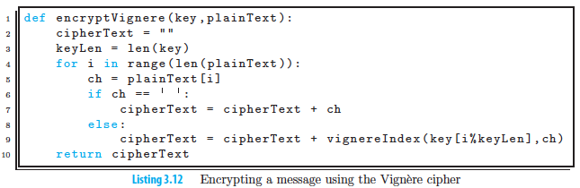
Vigenere Cipher

Slide 26
Other Ciphers
Notes:
https://www.youtube.com/watch?v=-yFZGF8FHSg
5:02 – 8:20

Slide 27
Summary
Introduced an important Python data type called strings–sequences of characters that provide a wide range of built-in operators and methods.
Strings provide:
Concatenation
Repetition
Indexing
Slicing
Length
Membership
We used string manipulation to implement some basic encryption algorithms. These algorithms
allowed us to illustrate iteration over characters in a string as well as the accumulator
pattern as it applies to strings. Finally, we used abstraction to build up a collection of small
functions that could be used to solve larger problems

